Slide 1
Predicting Fragment Distributions via Physics-Constrained Mixture Density Networks
Tory Smith

Slide 2
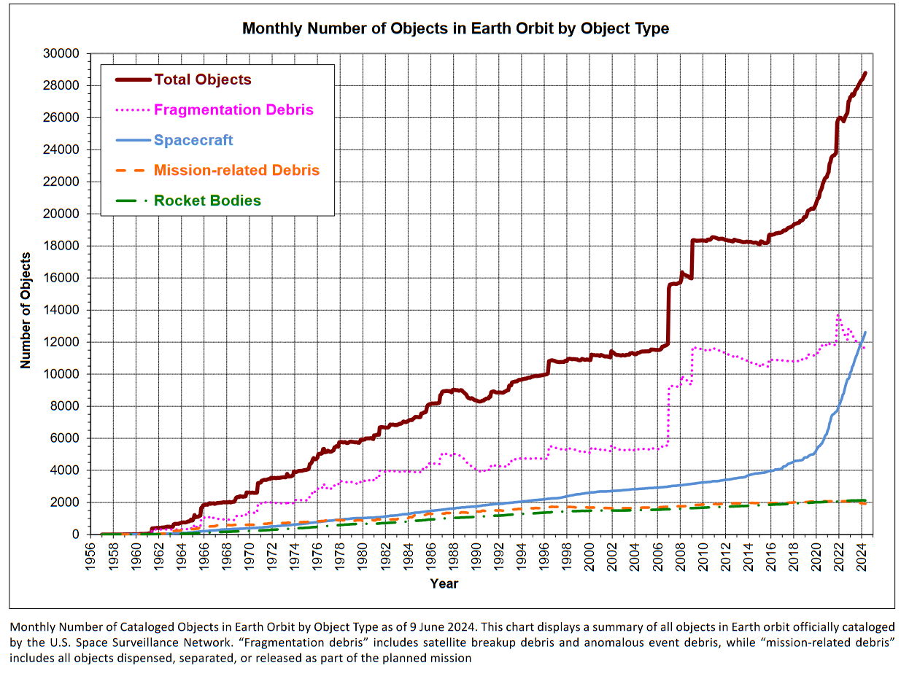
Exponential Increase in Number of Objects in Orbit
The number of satellites in orbit has been increasing significantly in recent years
Break-up models underpin long-term planning and policy decisions aimed at ensuring space sustainability
Inform design of more robust and resilient satellites
30000
Number of Objects
Collisions
0
1956
2025
Year
Nasa Orbital Debris Quarterly 28-3 (2024)

Slide 3
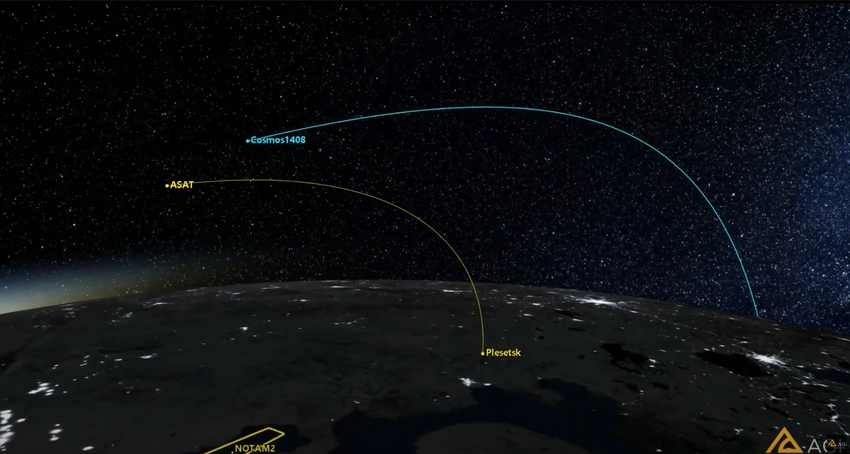

Hypervelocity Impacts
Hypervelocity impacts occur when the speed of sound of the materials involved is exceeded (from ~3 km/s to upwards of 15 km/s)
This results in two damage modes:
A diffuse cascade fragmentation initiated at the impact point
Global satellite collapse consequent to the propagation of shock waves through components connections and along the structure
https://www.youtube.com/watch?v=hfFArusJWu8
Notes:
The strong shock causes the material immediately around the impact to act as a liquid for a short time (essentially removing material strength as a factor)

Slide 4
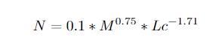
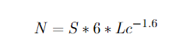
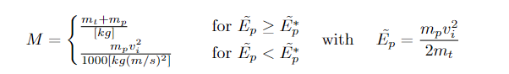
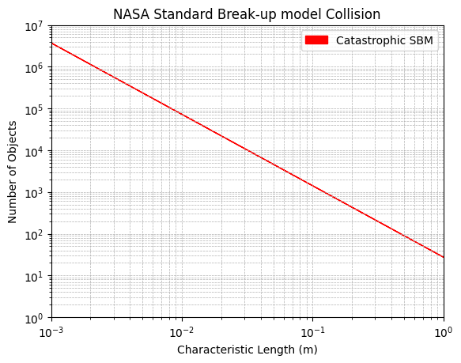
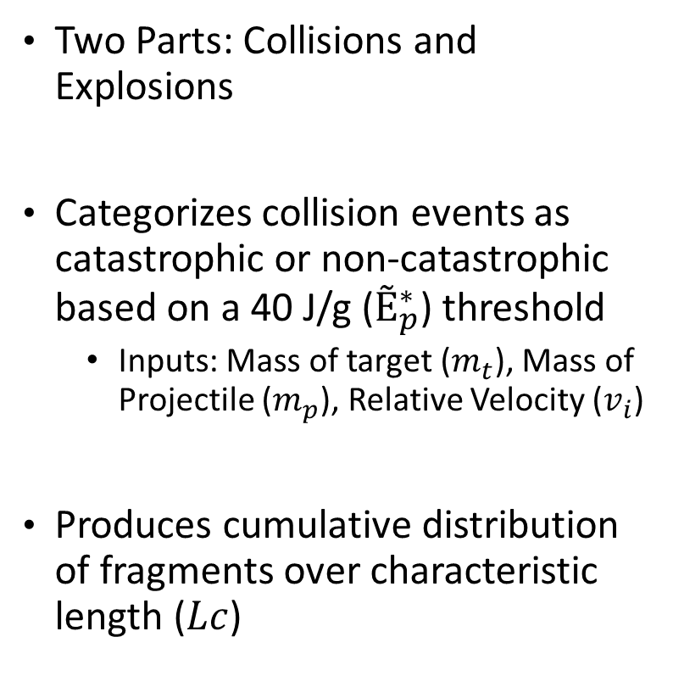
NASA Standard Break-up Model
Two Parts: Collisions and Explosions
Categorizes collision events as catastrophic or non-catastrophic based on a 40 J/g ($Ẽ_{p}^{∗}$) threshold
Inputs: Mass of target ($m_{t}$), Mass of Projectile ($m_{p}$), Relative Velocity ($v_{i}$)
Produces cumulative distribution of fragments over characteristic length ($Lc$)
Collision
Explosion
N. L. Johnson et al, “NASA’s new breakup model of evolve 4.0,” 2001

Slide 5
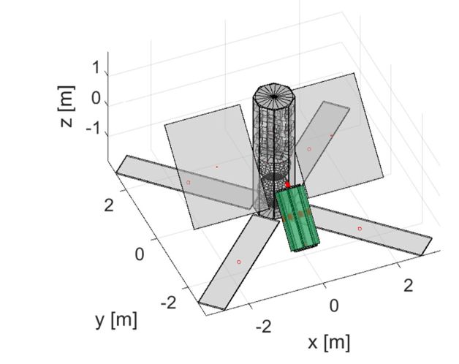
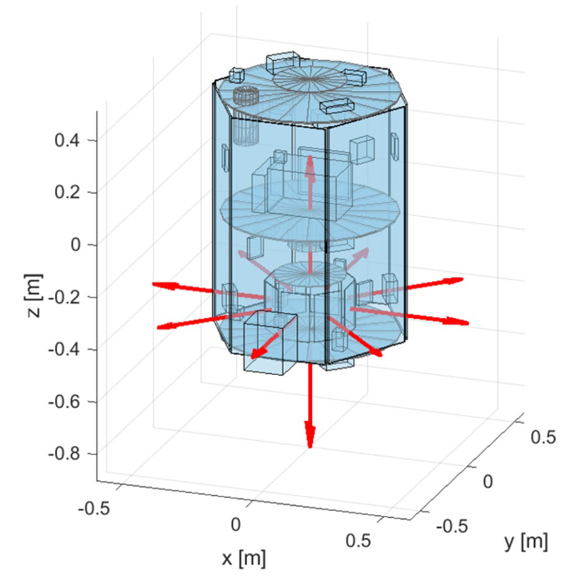
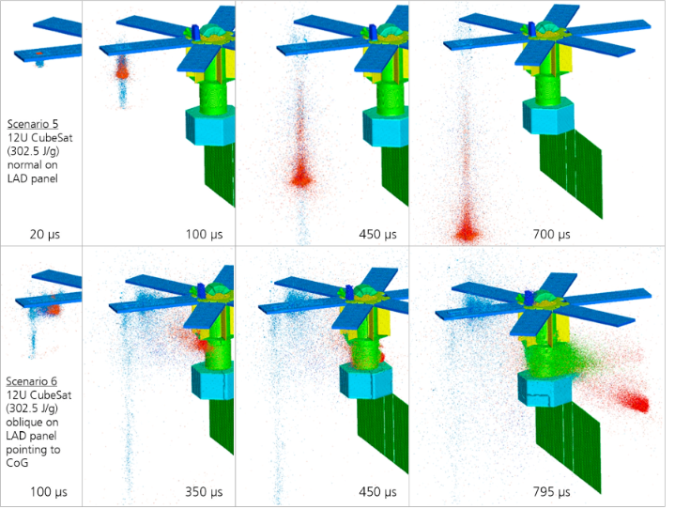
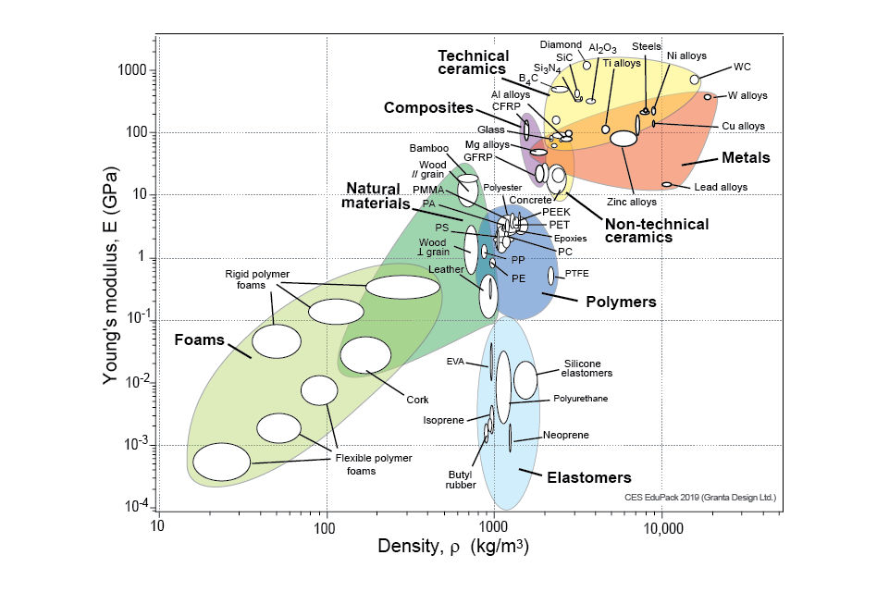
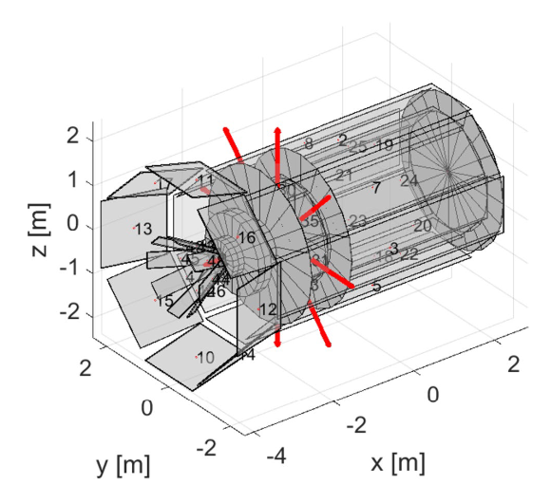
Limitations of the Standard Break-up Model
What’s missing?
Material Composition
Impact Geometry
Structural Complexity (Partial)
Schimmerohn et al, “Numerical investigation on the standard catastrophic breakup criteria” 2020
L. Olivieri et al,“Simulation of In-Space Fragmentation Events,” Aerotec. Missili Spaz., 2023

Slide 6
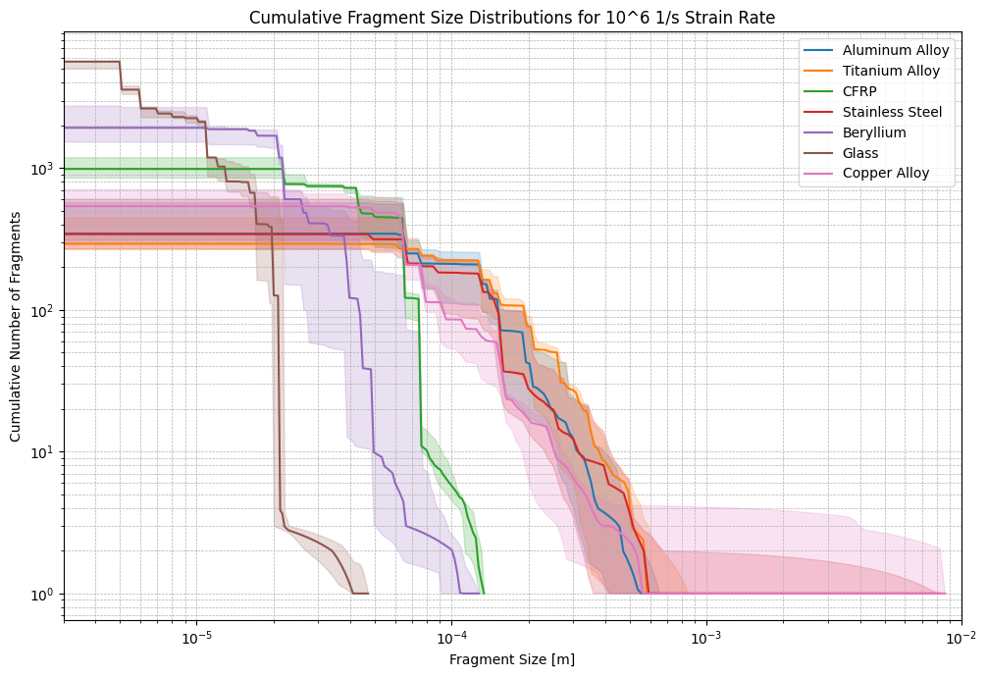
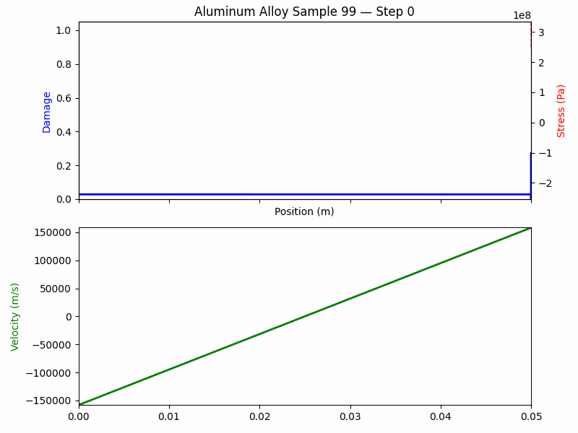
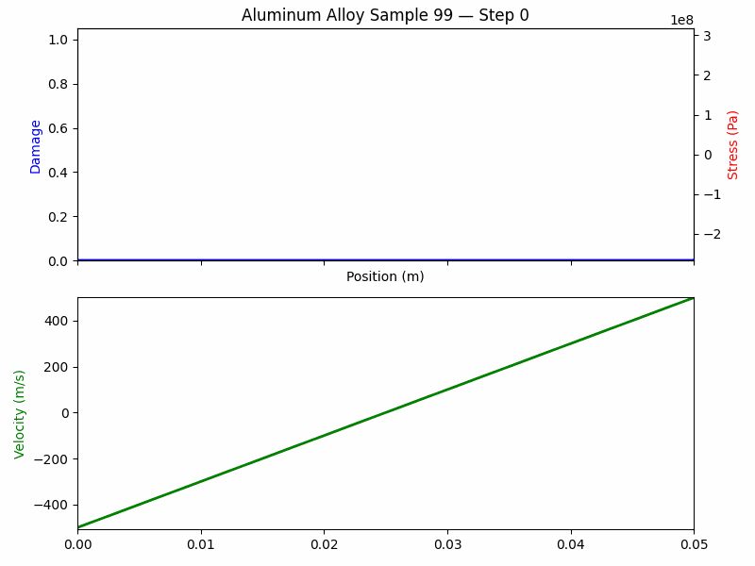
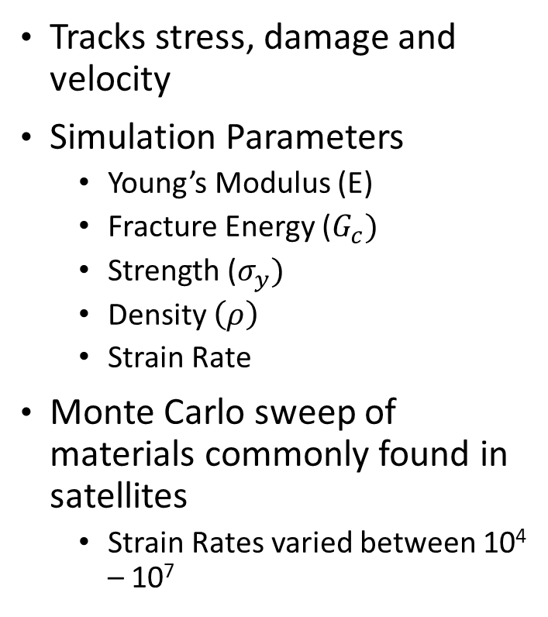
One-dimensional cohesive fracture simulation
Tracks stress, damage and velocity
Simulation Parameters
Young’s Modulus (E)
Fracture Energy ($G_{c})$
Strength ($σ_{y})$
Density $\left(ρ\right)$
Strain Rate
Monte Carlo sweep of materials commonly found in satellites
Strain Rates varied between 10⁴ – 10⁷
F. Zhou et al.“A cohesive model based fragmentation analysis: effects of strain rate and initial defects distribution,” 2005

Slide 7
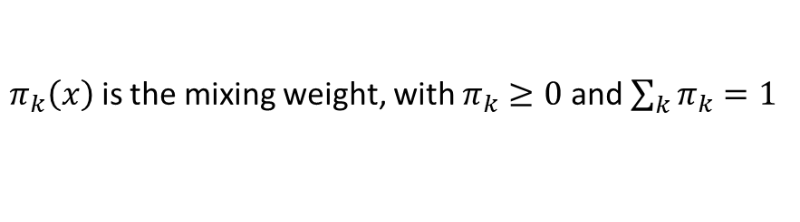
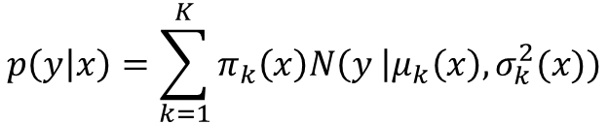
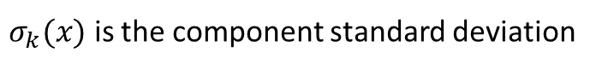
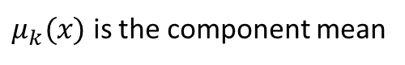
Mixture Density Network (MDN)
When the true conditional distribution can have several peaks (e.g. a physical system that might break into many small ones), a point estimate (MSE, MAE) will simply average them out.
MDNs turn a standard neural network into a probabilistic regressor capable of modeling multi-modal output distributions
$$p\left(y | x\right)=\sum_{k=1}^{K}{π_{k}\left(x\right)N\left(y \right|μ_{k}\left(x\right), σ_{k}^{2}(x))}$$
$π_{k}\left(x\right)$ is the mixing weight, with $π_{k}≥0$ and $\sum_{k}{π_{k}}=1$
$μ_{k}(x)$ is the component mean
$σ_{k}(x)$ is the component standard deviation

Slide 8
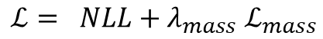
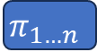

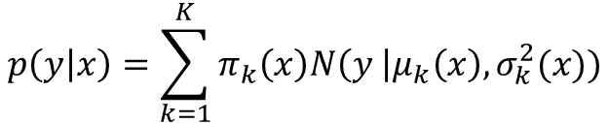
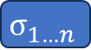
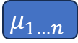
MDN Architecture
$$E$$
$$G_{c}$$
$$ρ$$
$$σ_{y}$$
Strain Rate
h
Softmax
$$π_{1…n }$$
$$p\left(y | x\right)=\sum_{k=1}^{K}{π_{k}\left(x\right)N\left(y \right|μ_{k}\left(x\right), σ_{k}^{2}(x))}$$
$$μ_{1…n}$$
Mass Conservation Penalty: $E\left[X\right] ×N_{frags} ≈V_{tot}$
Softplus
$ℒ= NLL+λ_{mass}$ $ℒ_{mass}$
$$σ_{1…n}$$
Bishop, C. M. (1994). Mixture density networks. Neural Computing Research Group Technical Report NCRG/94/004, Aston University

Slide 9
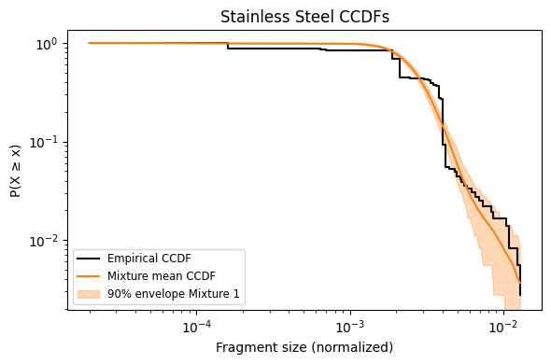
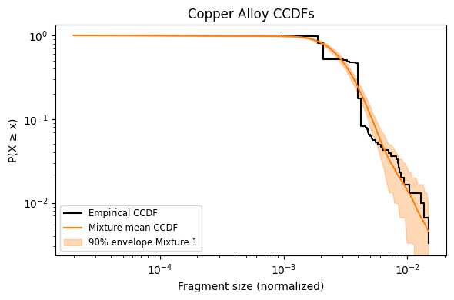
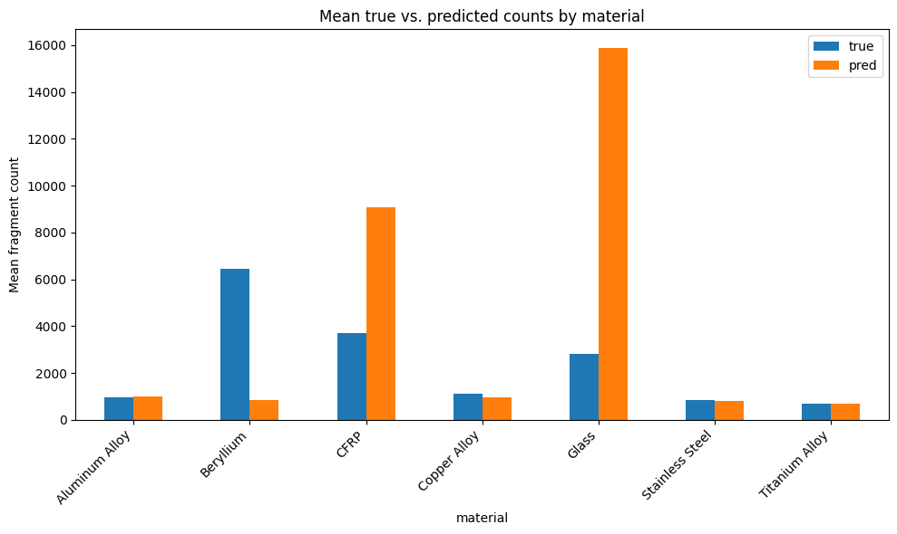
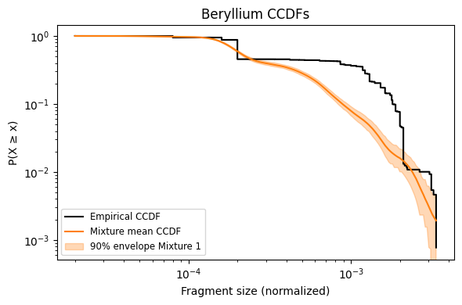
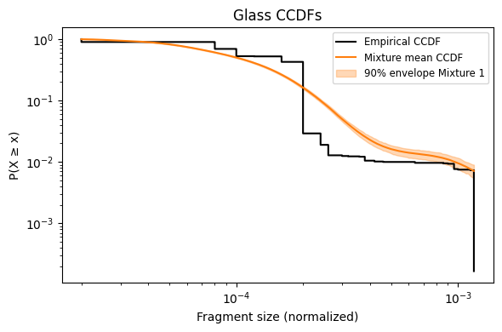
Results- Number of Fragments
The MDN captures the expected number of fragments of the ductile materials well
Struggles to capture the brittle materials and the polymer
Similar trend is found when looking at the Complementary Cumulative Distributions

Slide 10
Impact and Future Work
Impact
First step toward incorporating material contributions to satellite break-up models
Possibility for an efficient physics-based break-up model through phyiscs informed machine learning
Future Work
Investigate different PINN architectures (U-Net) that can incorporate the PDE and boundary conditions for stronger physics constraints
Move to 2D and 3D simulations

Slide 11
Questions

Slide 12
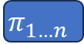


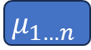
MDN U-NET Architecture
D
S
V
$$E$$
$$G_{c}$$
$$ρ$$
$$σ_{y}$$
Strain Rate
x
t
h
Softmax
$$π_{1…n }$$
$$μ_{1…n}$$
$ℒ= βNLL+λ_{mass}$ $ℒ_{mass}+λ_{PDE}ℒ_{PDE}+λ_{IC}ℒ_{IC}+λ_{BC}ℒ_{BC}$
Softplus
$$σ_{1…n}$$
Bishop, C. M. (1994). Mixture density networks. Neural Computing Research Group Technical Report NCRG/94/004, Aston University

Slide 13
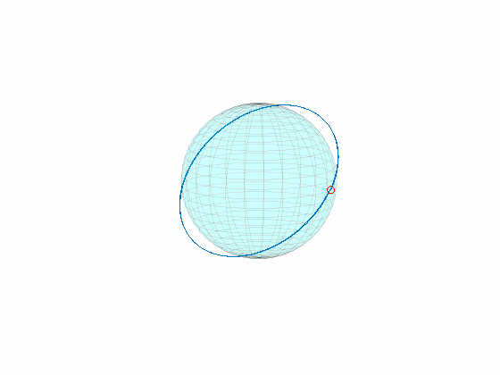
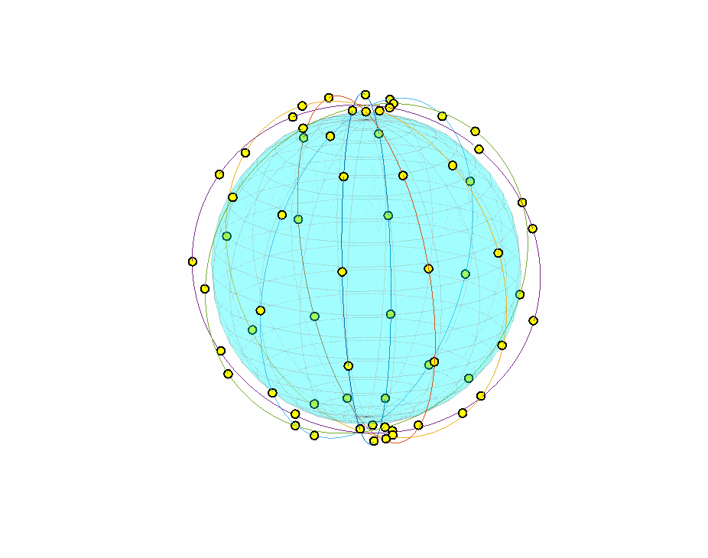
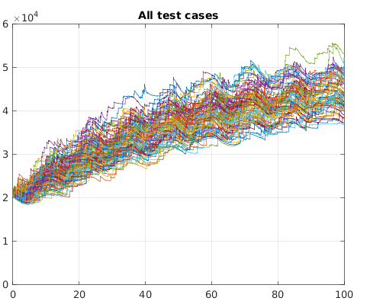
MIT Orbital Capacity Tool – Monte Carlo
# Objects in LEO
Debris Cloud Propagation
Large LEO Constellations
Year
Models Space traffic and individual debris
Provides statistical outcomes given some starting parameters
D. Jang et al., “A New Monte-Carlo Model for the Space Environment,” 2024

Slide 14
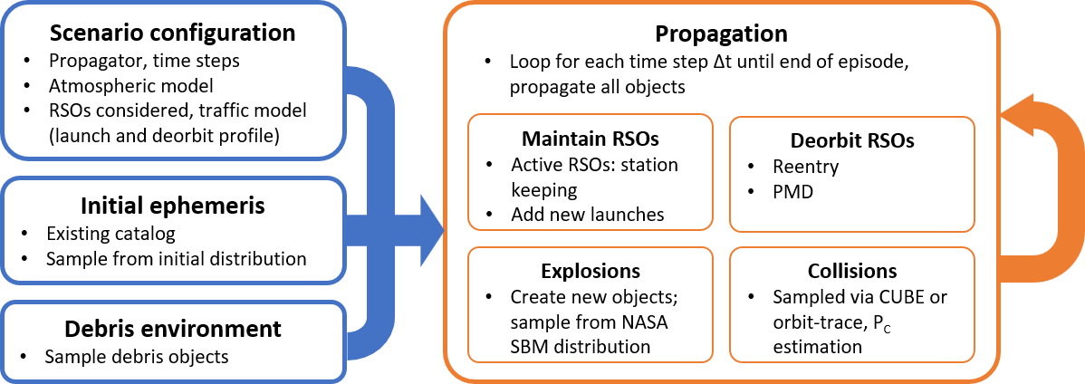
MOCAT-MC Architecture
D. Jang et al., “A New Monte-Carlo Model for the Space Environment,” 2024

Slide 15
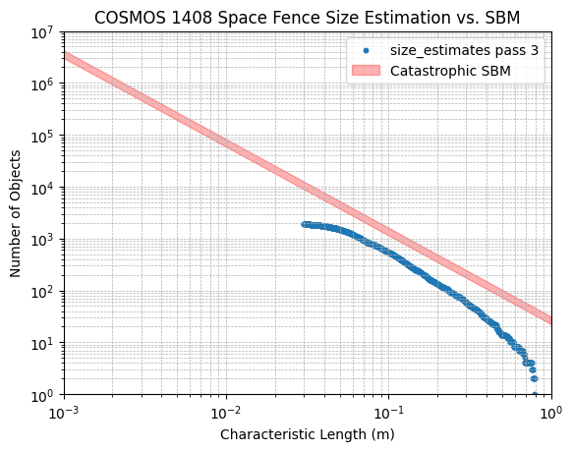
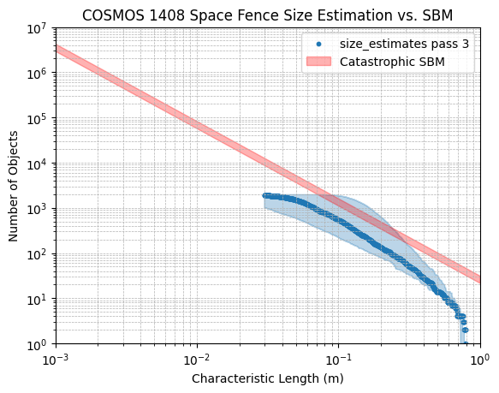
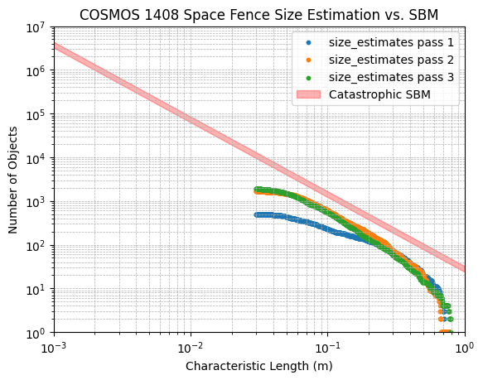
Results – COSMOS 1408
Russian Anti-Satellite Test on November 15th 2021
~2000 pieces of observable debris
Multiple Passes
Single Pass
https://www.youtube.com/watch?v=hfFArusJWu8
Notes:
The strong shock causes the material immediately around the impact to act as a liquid for a short time (essentially removing material strength as a factor)

Slide 16
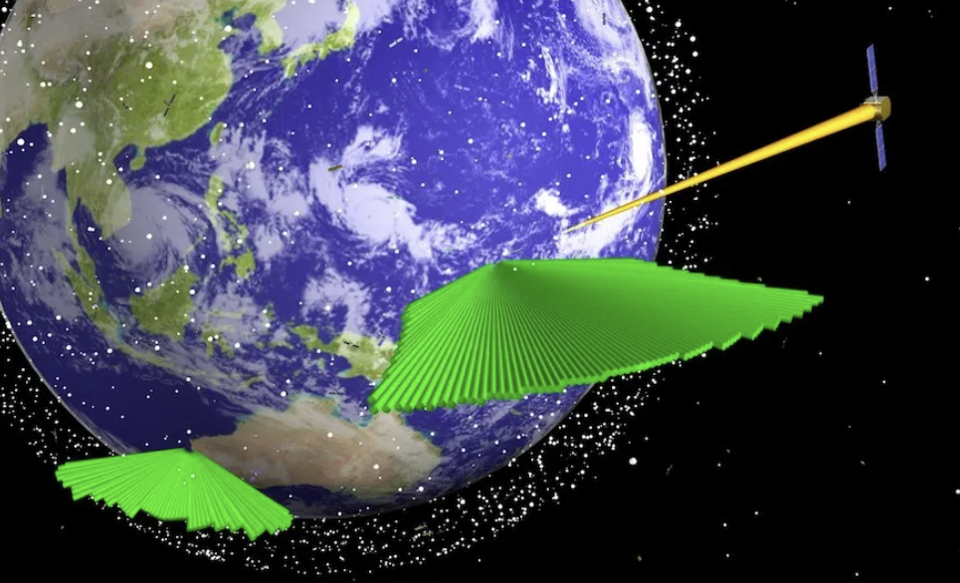
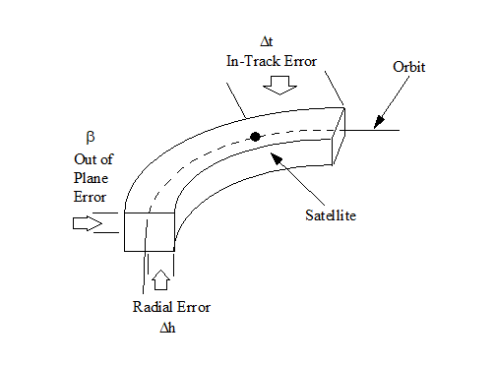
Space Fence
S-Band phased array radar (15 – 7.5 cm wavelength)
Can detect objects down to 2cm
Measurements correlated with an object using Beta angle residuals and time
https://spacenews.com/lockheed-martin-prepares-to-turn-on-u-s-air-force-space-fence-on-kwajalein-atoll/

Slide 17
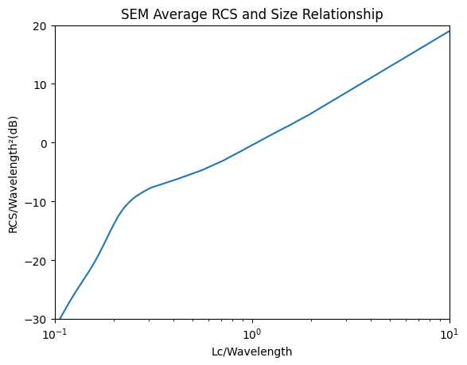
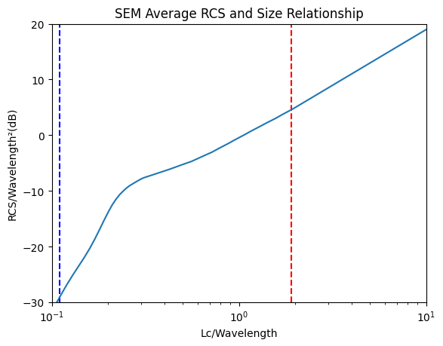
NASA Size Estimation Model
Converts Radar Cross Section (RCS) Measurements to characteristic lengths
Empirical relationship derived from hypervelocity collision experiments
Uses a piecewise function depending on the wavelength/Lc ratio
Rayleigh
Mie
Optical

